Slide 1
Spring Jersery

Slide 2
JAX-RS is an specification (just a definition) and Jersey is a JAX-RS implementation.

Slide 3
JAX-RS is an specification and Jersey is a JAX-RS implementation.- True
This can be understood relating it to OOPS principles JAX-RS is an Interface and Jersey is a class implementing that interface.
These Specification creates a STANDARD for developing and using the web services.
There are other JAX-RS implementations too like wink, RestEasy.
JAX-RS is a specification which specifies how can we implement the web services,that what would be input type, input format, output type, its format, its configuration etc.Its Just a type declaration and its implementation are these libraries, Jersey, wink RestEasy etc.
Further, Java also have specification like JPA(Java Persistence API) and like mentioned above there is Hibernate which is an implementation of JPA.
Using JAX-RS alone can not implement REST, need to register Jersey as the servlet dispatcher for REST requests on web.xml

Slide 4
REST is an architecture, which inherently uses servlets.
No, it is not. REST is an architecture style which can be implemented using servlets, but does not inherently use them, nor inherently have anything to do with Java.

Slide 5
Spring
Spring framework is an open source Java platform that provides comprehensive infrastructure support for developing robust Java applications very easily and very rapidly. Spring framework was initially written by Rod Johnson and was first released under the Apache 2.0 license in June 2003. This tutorial has been written based on Spring Framework version 4.1.6 released in Mar 2015.
Spring is lightweight when it comes to size and transparency. The basic version of Spring framework is around 2MB.
The core features of the Spring Framework can be used in developing any Java application, but there are extensions for building web applications on top of the Java EE platform. Spring framework targets to make J2EE development easier to use and promotes good programming practices by enabling a POJO-based programming model.

Slide 6
J2EE is a platform-independent, Java-centric environment from Sun for developing, building and deploying Web-based enterprise applications online. The J2EE platform consists of a set of services, APIs, and protocols that provide the functionality for developing multitiered, Web-based applications.

Slide 7
JavaBeans Enterprise Java Beans (EJB) Spring (must read)
Prior to the advent of Enterprise Java Beans (EJB), Java developers needed to use JavaBeans to create Web applications. Although JavaBeans helped in the development of user interface (UI) components, they were not able to provide services, such as transaction management and security, which were required for developing robust and secure enterprise applications. The advent of EJB was seen as a solution to this problem EJB extends the Java components, such as Web and enterprise components, and provides services that help in enterprise application development. However, developing an enterprise application with EJB was not easy, as the developer needed to perform various tasks, such as creating Home and Remote interfaces and implementing lifecycle callback methods which lead to the complexity of providing code for EJBs Due to this complication, developers started looking for an easier way to develop enterprise applications.

Slide 8
The Spring framework has emerged as a solution to all these complications This framework uses various new techniques such as Aspect-Oriented Programming (AOP), Plain Old Java Object (POJO), and dependency injection (DI), to develop enterprise applications, thereby removing the complexities involved while developing enterprise applications using EJB, Spring is an open source lightweight framework that allows Java EE 7 developers to build simple, reliable, and scalable enterprise applications. This framework mainly focuses on providing various ways to help you manage your business objects. It the development of Web applications much easier as compared to classic Java frameworks and Application Programming Interfaces (APIs), such as Java database connectivity(JDBC), JavaServer Pages(JSP), and Java Servlet.
The Spring framework can be considered as a collection of sub-frameworks, also called layers, such as Spring AOP. Spring Object-Relational Mapping (Spring ORM). Spring Web Flow, and Spring Web MVC. You can use any of these modules separately while constructing a Web application. The modules may also be grouped together to provide better functionalities in a Web application.

Slide 9
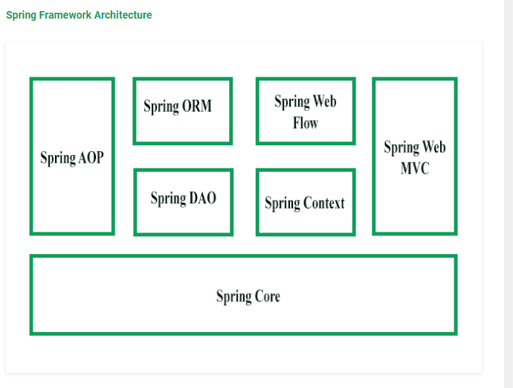
The Spring framework consists of seven modules which are shown in the above Figure. These modules are Spring Core, Spring AOP, Spring Web MVC, Spring DAO, Spring ORM, Spring context, and Spring Web flow. These modules provide different platforms to develop different enterprise applications; for example, you can use Spring Web MVC module for developing MVC-based applications.

Slide 10
https://www.mkyong.com/webservices/jax-rs/jersey-spring-integration-example/
https://www.mkyong.com/spring3/spring-3-hello-world-example/
https://www.mkyong.com/spring/spring-auto-scanning-components/
https://www.mkyong.com/webservices/jax-rs/jersey-hello-world-example/
https://www.mkyong.com/webservices/jax-rs/jax-rs-path-uri-matching-example/

Slide 11
IoC Container
IoC Container
Using BeanFactory
Using ApplicationContext
The IoC container is responsible to instantiate, configure and assemble the objects. The IoC container gets informations from the XML file and works accordingly. The main tasks performed by IoC container are:
to instantiate the application class
to configure the object
to assemble the dependencies between the objects
There are two types of IoC containers. They are:
BeanFactory
ApplicationContext
Difference between BeanFactory and the ApplicationContext
The org.springframework.beans.factory.BeanFactory and the org.springframework.context.ApplicationContextinterfaces acts as the IoC container. The ApplicationContext interface is built on top of the BeanFactory interface. It adds some extra functionality than BeanFactory such as simple integration with Spring's AOP, message resource handling (for I18N), event propagation, application layer specific context (e.g. WebApplicationContext) for web application. So it is better to use ApplicationContext than BeanFactory.

Slide 12
Dependency Injection in Spring https://www.javatpoint.com/dependency-injection-in-spring
Dependency Injection (DI) is a design pattern that removes the dependency from the programming code so that it can be easy to manage and test the application. Dependency Injection makes our programming code loosely coupled. To understand the DI better, Let's understand the Dependency Lookup (DL) first:
Dependency Lookup
The Dependency Lookup is an approach where we get the resource after demand. There can be various ways to get the resource for example:
A obj = new AImpl();
In such way, we get the resource(instance of A class) directly by new keyword. Another way is factory method:
A obj = A.getA();
This way, we get the resource (instance of A class) by calling the static factory method getA().
Alternatively, we can get the resource by JNDI (Java Naming Directory Interface) as:
Context ctx = new InitialContext();
Context environmentCtx = (Context) ctx.lookup("java:comp/env");
A obj = (A)environmentCtx.lookup("A");
There can be various ways to get the resource to obtain the resource. Let's see the problem in this approach.

Slide 13
Problems of Dependency Lookup
There are mainly two problems of dependency lookup.
tight coupling The dependency lookup approach makes the code tightly coupled. If resource is changed, we need to perform a lot of modification in the code.
Not easy for testing This approach creates a lot of problems while testing the application especially in black box testing.
Dependency Injection
The Dependency Injection is a design pattern that removes the dependency of the programs. In such case we provide the information from the external source such as XML file. It makes our code loosely coupled and easier for testing. In such case we write the code as:
class Employee{
Address address;
Employee(Address address){
this.address=address;
}
public void setAddress(Address address){
this.address=address;
}
}

Slide 14
In such case, instance of Address class is provided by external souce such as XML file either by constructor or setter method.
Two ways to perform Dependency Injection in Spring framework
Spring framework provides two ways to inject dependency
By Constructor
By Setter method
https://www.javatpoint.com/spring-tutorial-dependency-injection-by-constructor
https://www.javatpoint.com/spring-tutorial-dependency-injection-by-setter-method

